Slide 1
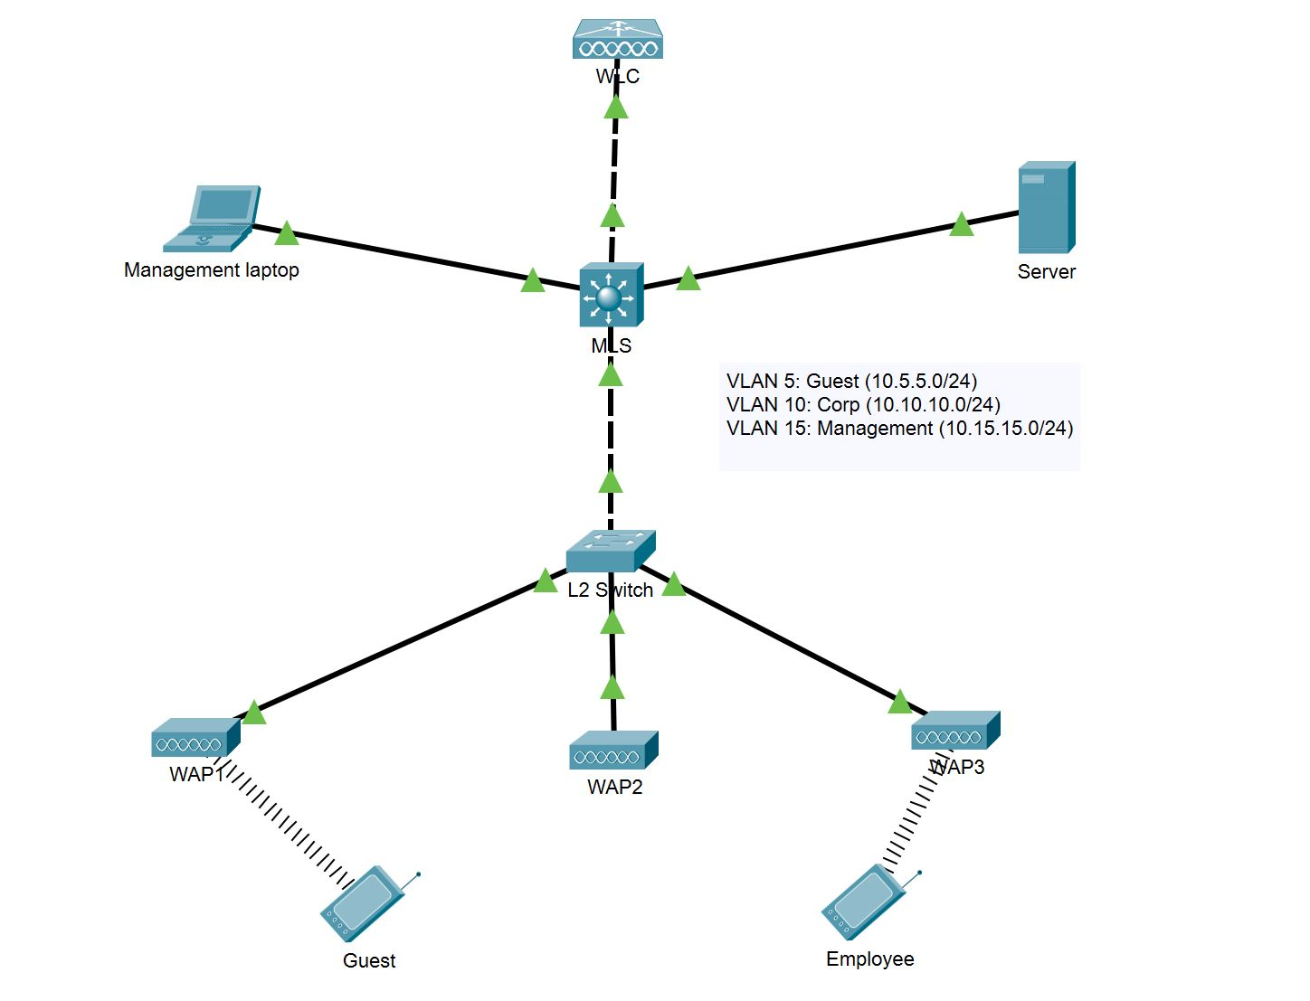
Authentication with 802.1X. Wireless networking concepts
Lecture 5
SoftUni Team
Technical Trainers
Software University
http://softuni.bg

Slide 2
Table of Contents
Authentication with 802.1X
Wireless networking concepts
Demonstration

Slide 3
Authentication with 802.1X

Slide 4
AAA
AAA: Authentication, Authorization and Accounting
Authentication – “Who are you? Prove it!”
Authorization – “This is where you have access and where you do not”
Accounting – “I am recording all (un)successful login attempts”
Often a single server plays the three roles but can be multiple servers as well

Slide 5
802.1X
IEEE 802.1X is an IEEE Standard for Port-based Network Access Control (PNAC)
Part of the IEEE 802.1 group of networking protocols
Provides authentication mechanism to devices asking to attach to a LAN or a WLAN
Uses Extensible Authentication Protocol (EAP) over LAN – known as EAPOL

Slide 6
The participants in 802.1X
Supplicant - the end device requesting access
Authenticator – usually a switch or AP which is to provide access
Authentication Server - the device which makes the decision (grant/deny access) Usually RADIUS server

Slide 7
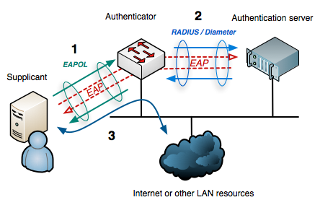
802.1X

Slide 8
Why 802.1X?
The switches and access points do not need to know how to authenticate the client
They (authenticators) simply pass the authentication information between the client and the authentication server
That is why it is easier for 802.1X to support many authentication methods

Slide 9
802.1X and EAP
802.1x uses EAP to facilitate the communications between the participants
Common EAP authentication types:
EAP-MD5 - minimal security, one-way authentication
EAP-TLS - mutual authentication, secure but no very easy to adopt
EAP-TTLS - mutual authentication (optional client certificate)
EAP-PEAP - most popular method, has an “outer” and “inner” methods, developed by Cisco, Microsoft and RSA Security

Slide 10
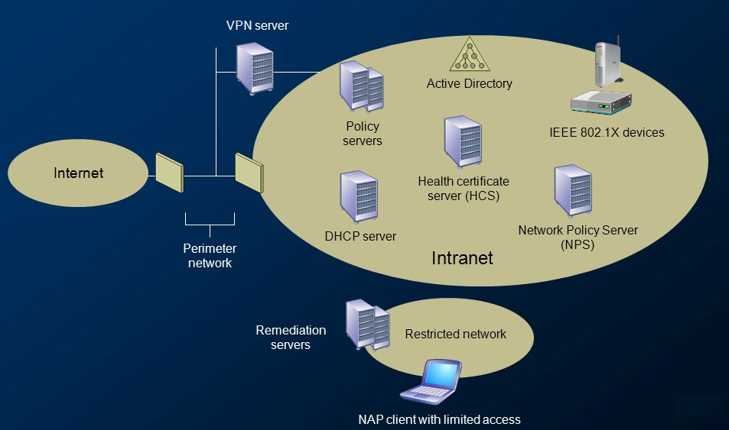
Network Access Protection

Slide 11
Wireless networking concepts

Slide 12

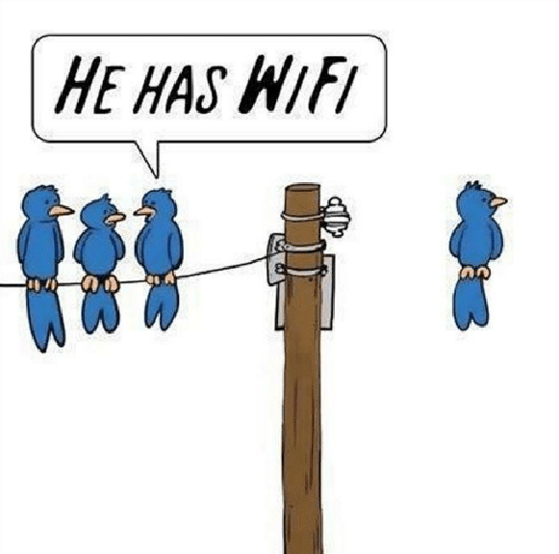
Cable vs Wireless?
Speed
Signal quality
Mobility
Device adaptability
Security
Interference

Slide 13
802.11 standards
IEEE Standard | 802.11b | 802.11a | 802.11g | 802.11n | 802.11ac | 802.11ax
Friendly name | WiFi 1 | WiFi 2 | WiFi 3 | WiFi 4 | WiFi 5 | WiFi 6
Year adopted | 1999 | 1999 | 2003 | 2009 | 2014 | 2019
Frequency | 2.4 Ghz | 5 Ghz | 2.4 Ghz | 2.4/5 Ghz | 5 Ghz | 2.4/5 Ghz
Max data rate | 11 Mbps | 54 Mbps | 54 Mbps | 450 Mbps | 1.7 Gbps | 2.4 Gbps
Typical range indoors* | 35 m | 35 m | 38 m | 70 m | 35 m | -
Typical range outdoors* | 140 m | 120 m | 140 m | 250 m | 250 m | 250 m

Slide 14
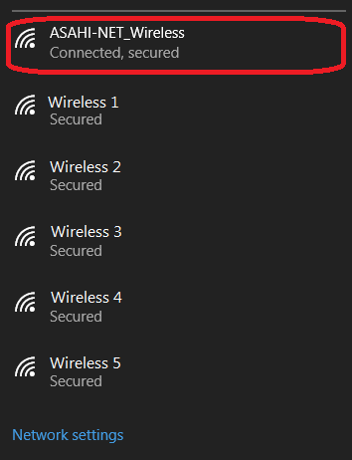
SSID
SSID: Service Set Identifier
This is the name of the wireless network (not the Access Point name)
It is up to 32 characters in length
A single AP can broadcast multiple SSIDs
Should you hide your SSID?

Slide 15
Wireless security
Hiding the SSID (“not the best” security)
MAC ID filtering
Static client IP addressing
802.11 security (next slide)

Slide 16
802.11 security
WEP - very weak, deprecated
WPA - better than WEP, still risky
WPA2 - the de facto standard
WPA2 (TKIP) - risky
WPA2 (AES)
WPA2-PSK vs WPA2-Enterprise (which uses EAP)
WPA3 - improved general Wi-Fi encryption
WPA3 - personal (uses Simultaneous Authentication of Equals (SAE) vs PSK)
WPA3 - enterprise (targets large-scale Wi-Fi with optional 192-bit security)
Better security

Slide 17
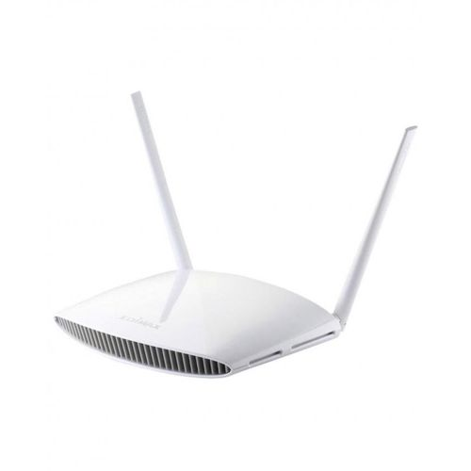
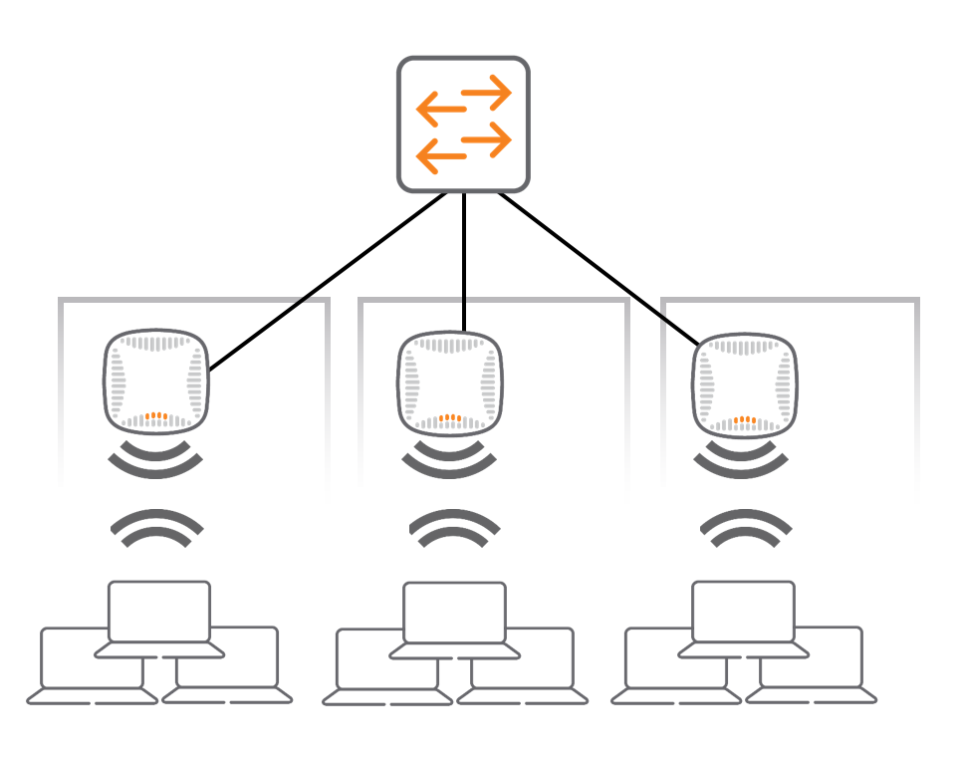
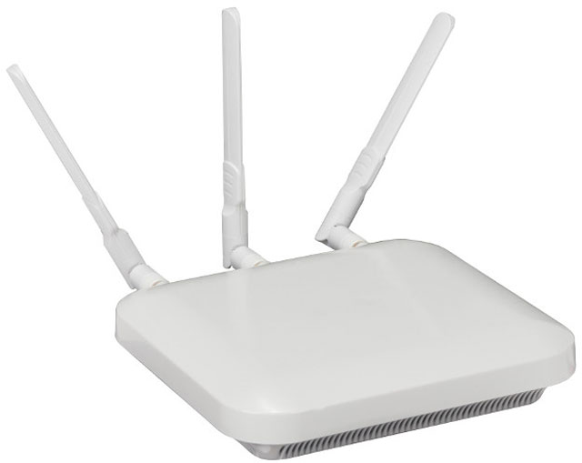
Wireless devices management
APs in standalone mode
APs controlled by a controller

Slide 18




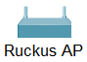
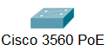
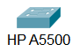




VLAN 5 (guest): 10.5.5.0/24
Internet
VLAN 10 (corporate): 10.10.10.0/24
Corporate WEB and DNS Server
SSID:
NetFund-Guest
SSID:
NetFund-Corporate
ge1/0/26
fe0/0/0
g0/1
g0/2
ge1/0/25
ge1/0/27
fe0/0/1

Slide 19
Demonstration

Slide 20

Summary
Authentication with 802.1X
Wireless networking concepts
Demonstration
…
…
…

Slide 22












SoftUni Diamond Partners

Slide 23


Educational Partners

Slide 24
Trainings @ Software University (SoftUni)
Software University – High-Quality Education, Profession and Job for Software Developers
softuni.bg, about.softuni.bg
Software University Foundation
softuni.foundation
Software University @ Facebook
facebook.com/SoftwareUniversity
Software University Forums
forum.softuni.bg
Notes:
24

